Slide 1
Python Integration In Power BI
Mark Gulati Power BI User Group Berlin 20.09.2018

Slide 2
Overview
Data Model
Python script
Visualization
Python custom visual

Slide 3
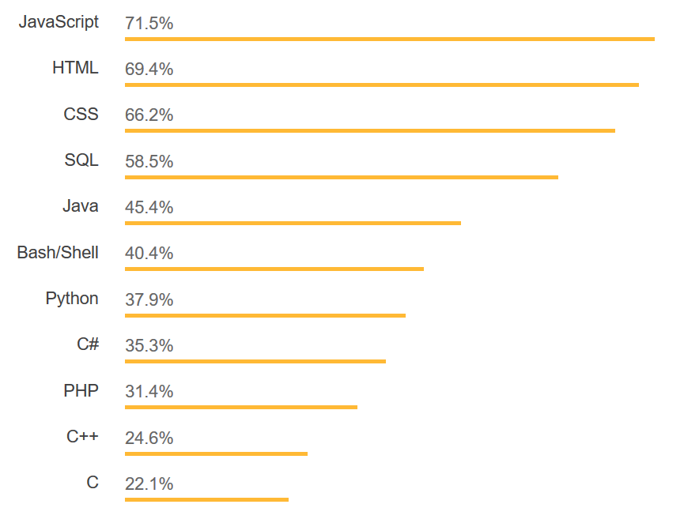
What is Python?
Python is a programming language
Displaced C# on StackOverflow.com
Rapidly displacing R in data space
How is it better than R?
Stackoverflow.com

Slide 4
Python vs R
R
Data Science
Data Visualization
Python
Data Science
Data Visualization
ETL

Slide 5
Data cleaning, prediction and clustering
Python script in the Query Editor
Data cleaning
Prediction
Clustering

Slide 6
Better visualizations
Python visuals are just like R visuals
Do update with data refreshes automatically.
Cross-filtering works
Limitation: visual is not interactive

Slide 7
Python script in Query Editor
Import data
Clean and transform data
Generate clusters, assign scores according to predictive model

Slide 8
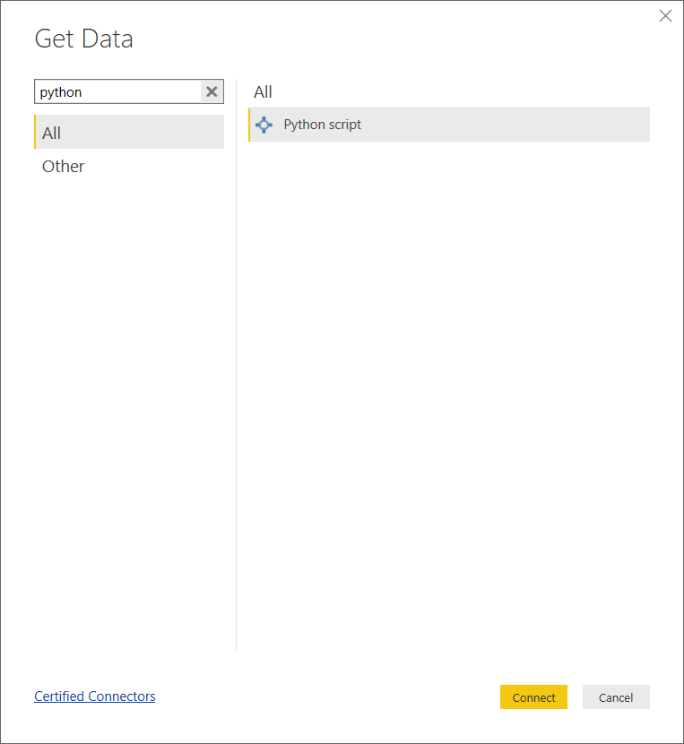

Slide 9
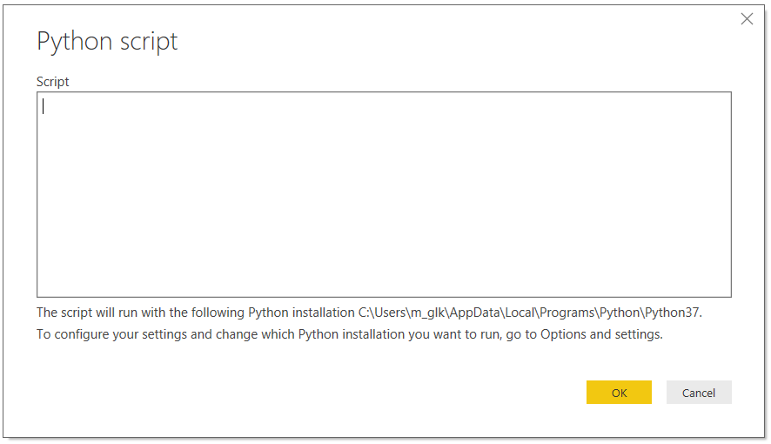

Slide 10
Data cleaning with numpy and pandas
Dropping Columns in a DataFrame
Changing the Index of a DataFrame
Tidying up Fields in the Data
Combining str Methods with NumPy to Clean Columns
Cleaning the Entire Dataset Using the applymap Function
Renaming Columns and Skipping Rows
See here: https://realpython.com/python-data-cleaning-numpy-pandas/

Slide 11
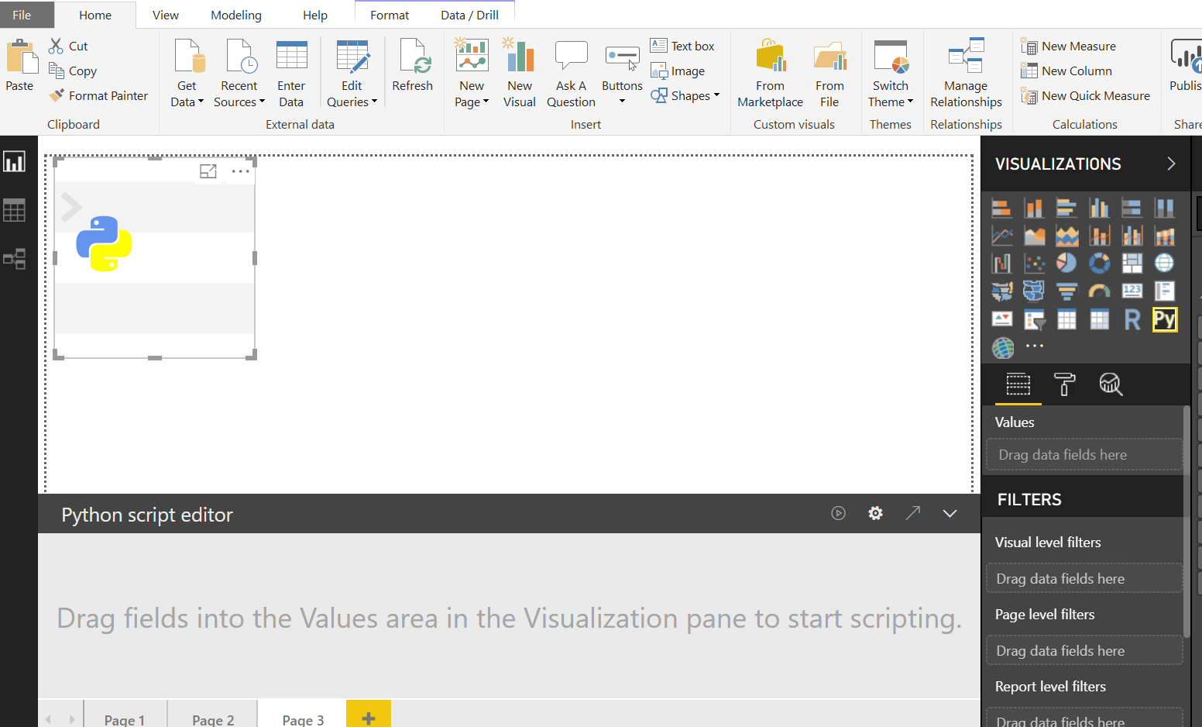
absentdata.com

Slide 12
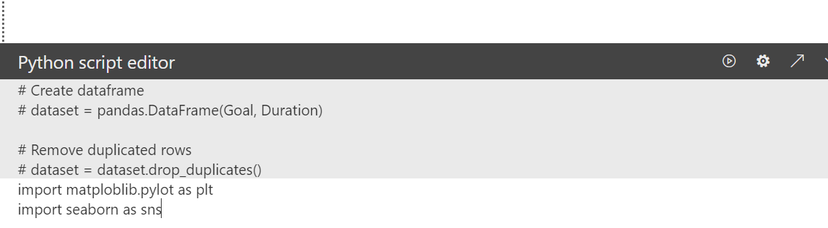
absentdata.com

Slide 13
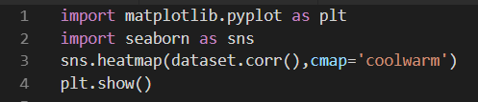
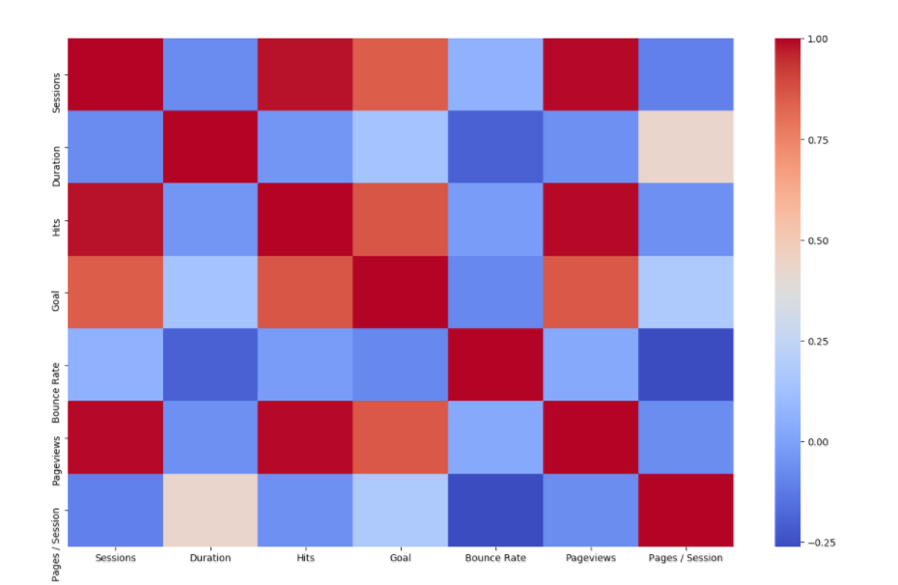

Slide 14
Libraries supported in Power BI
Seaborn
matplotlib
Altair
Scikit-Learn
…and many more
See: https://powerbi.microsoft.com/en-us/blog/pythonblogepisode1/

Slide 15
Thank you
Mark Gulati
Power BI User Group Berlin
20.09.2018

